Slide 1
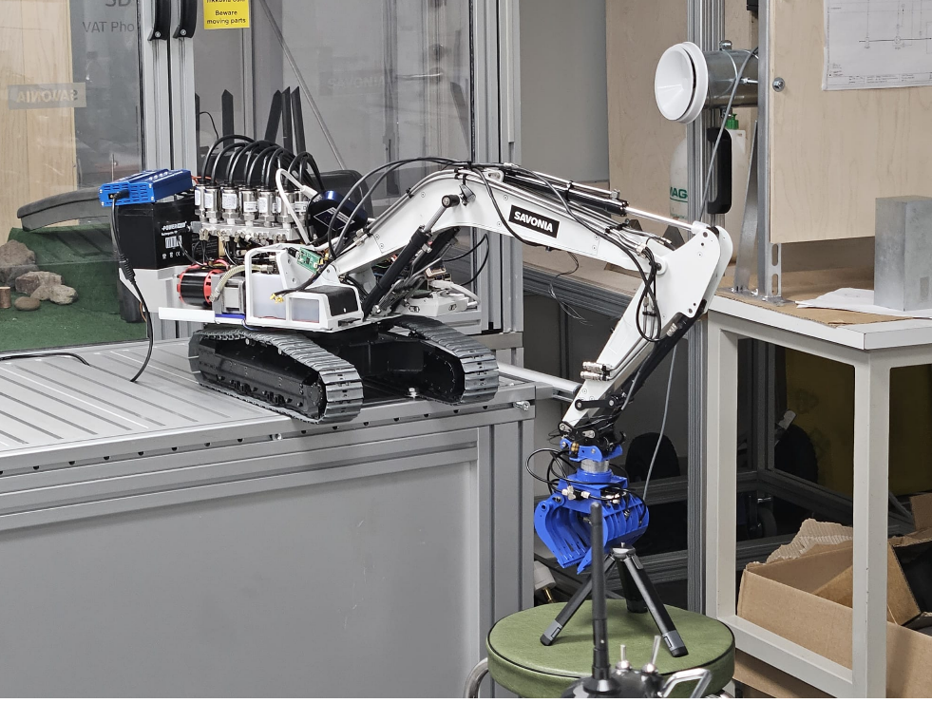
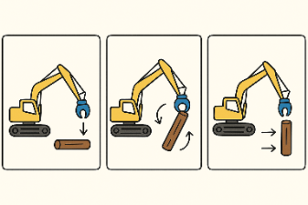

Slide 2
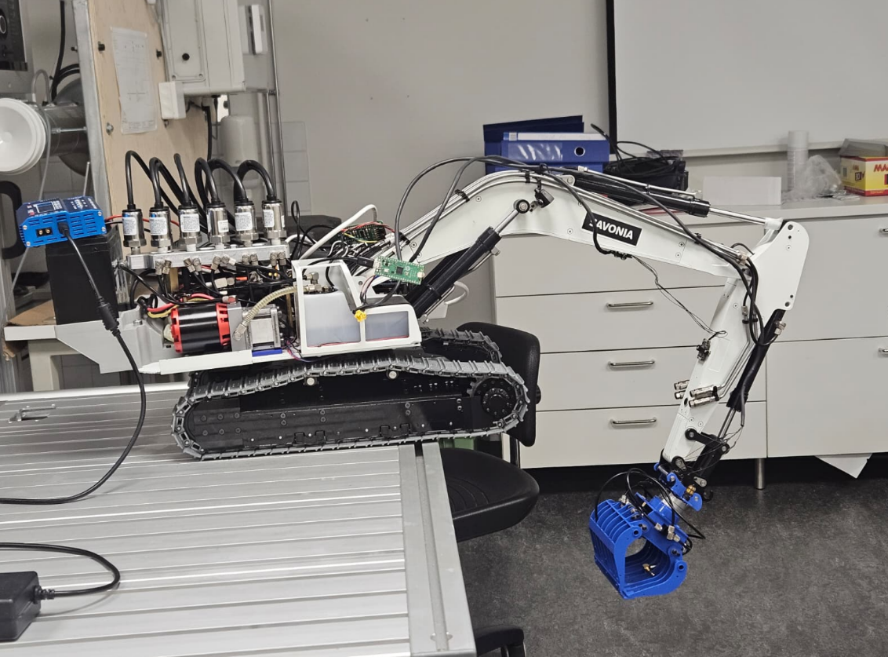

Slide 3
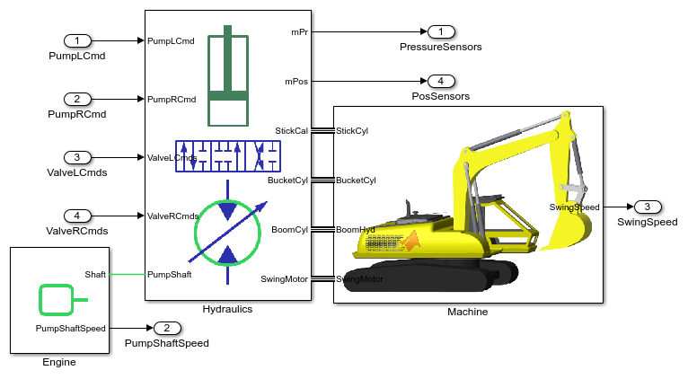

Slide 4
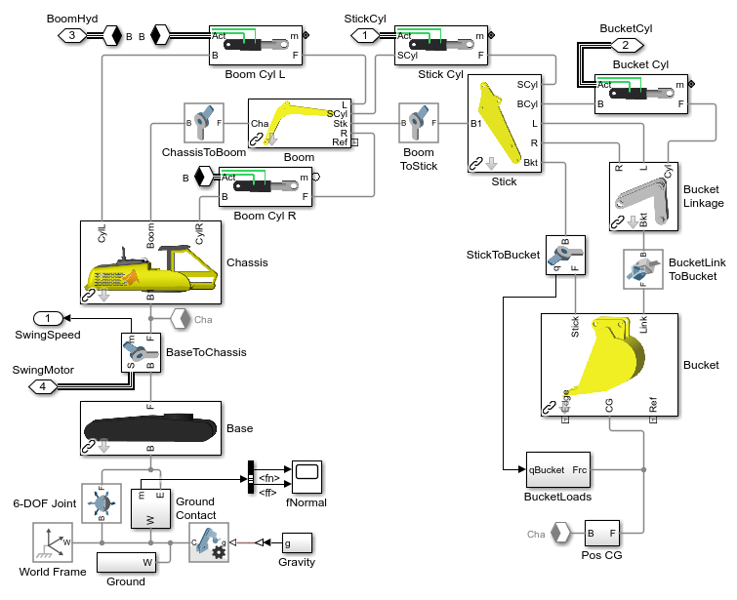










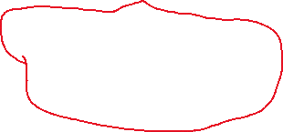

Slide 5
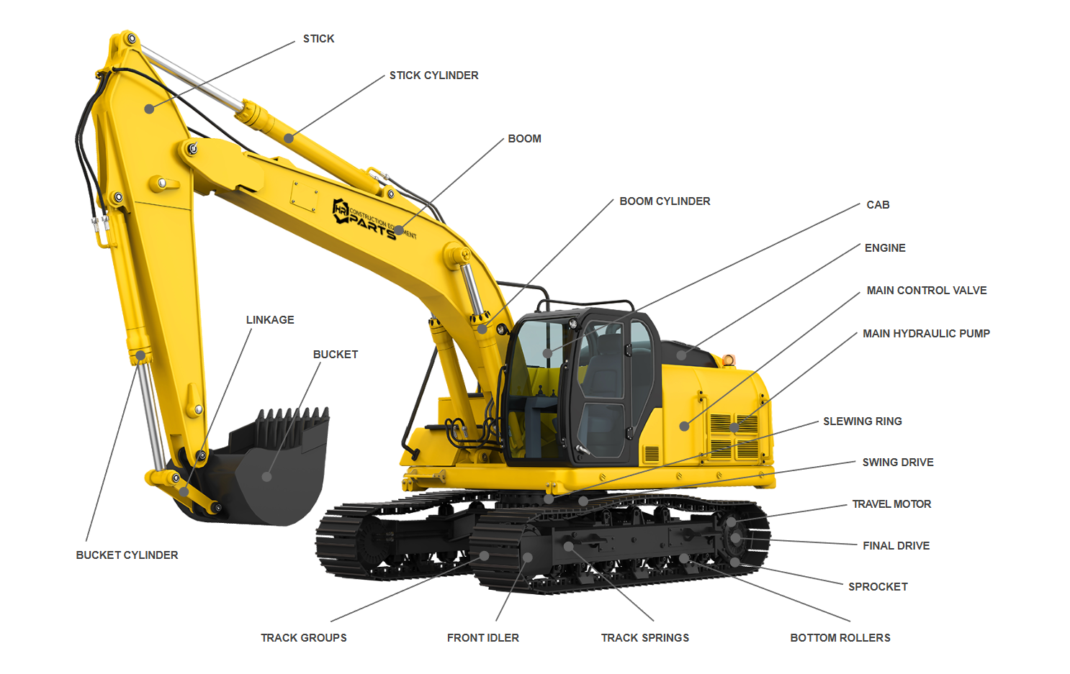

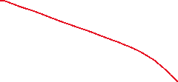

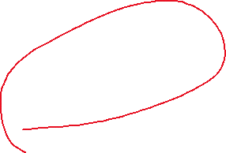
Notes:
https://www.hrparts.com/blog/post/excavator-parts-diagram-interactive?srsltid=AfmBOoow4UQrs_g9Zim_wBUuySZboLPSEy-IT9ZWmgwKT8euKwA0Q84t#bucket-cylinder-def

Slide 6
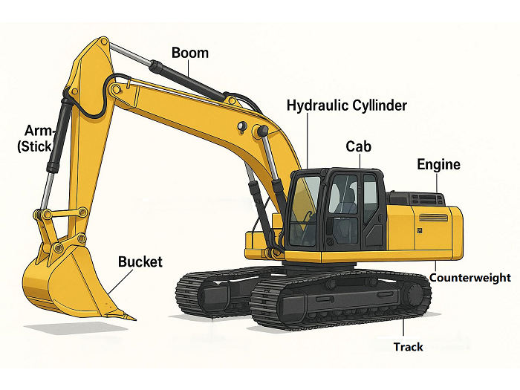

Slide 7
Model 1

Slide 8
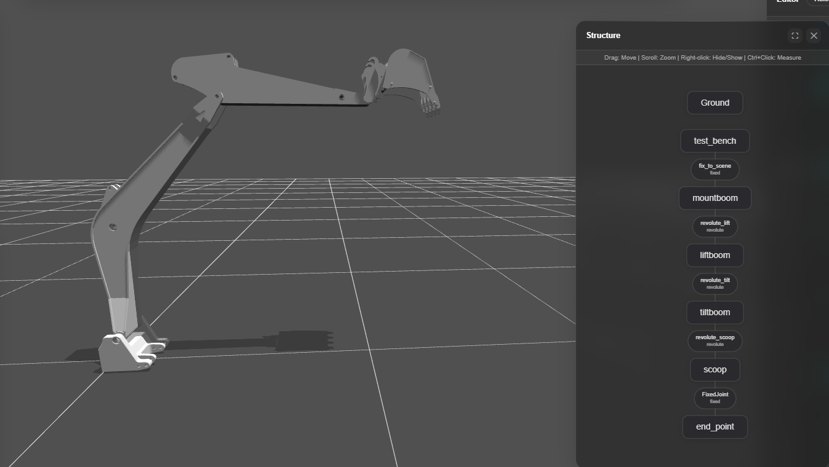

Slide 9
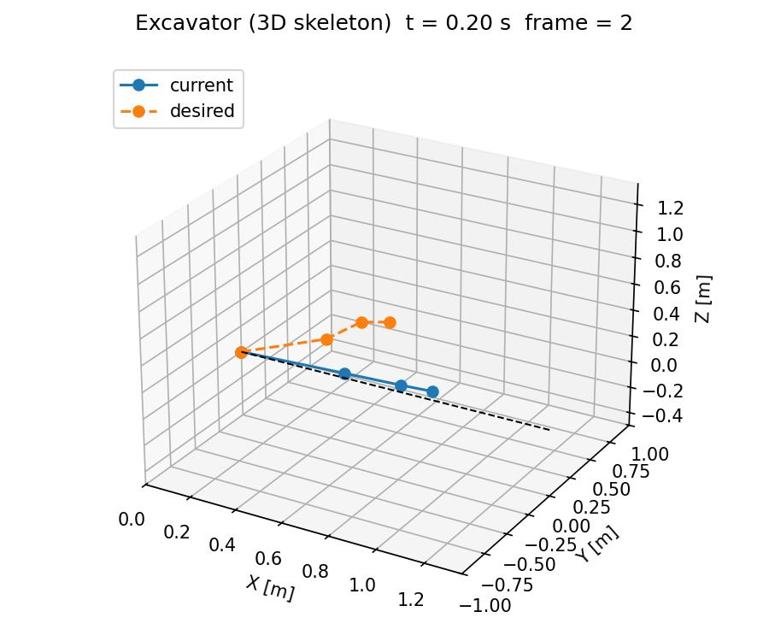
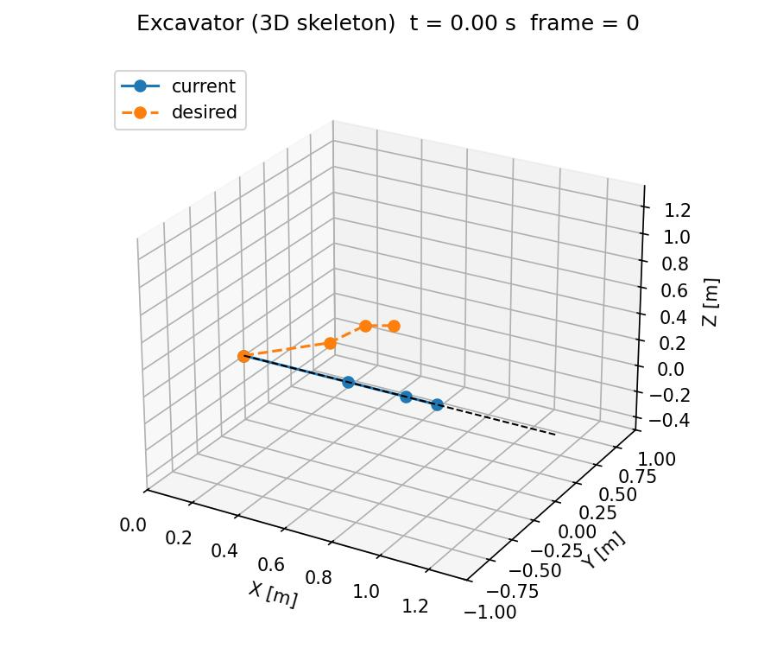



Slide 10
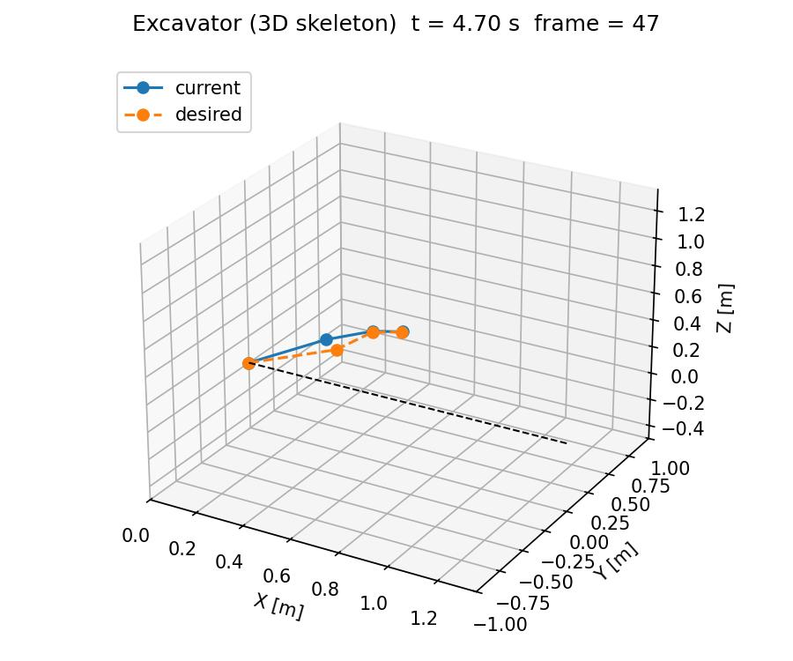




Slide 11
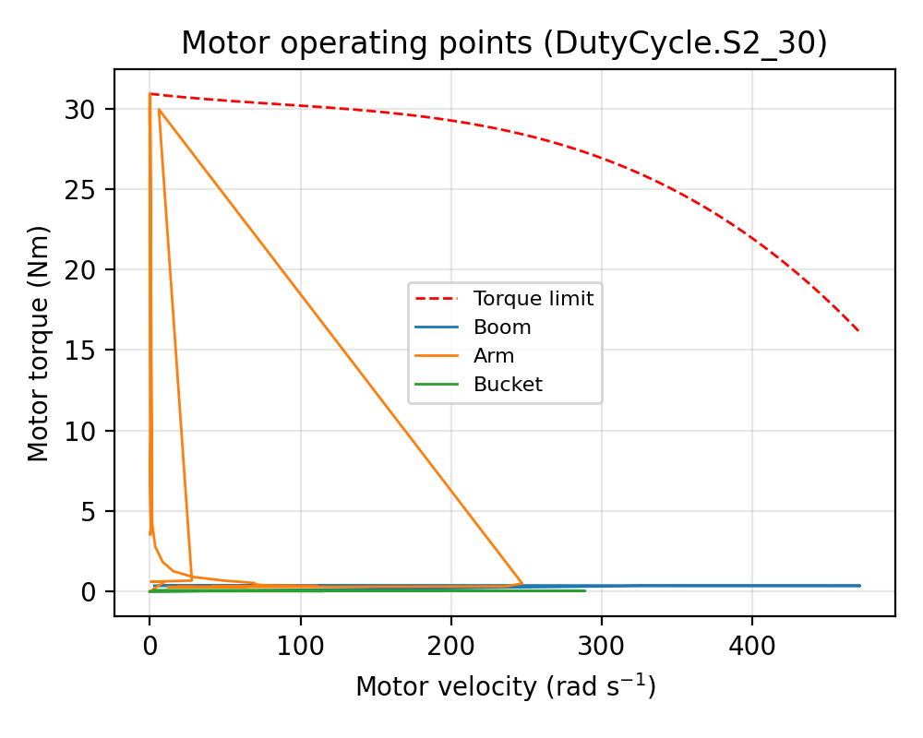
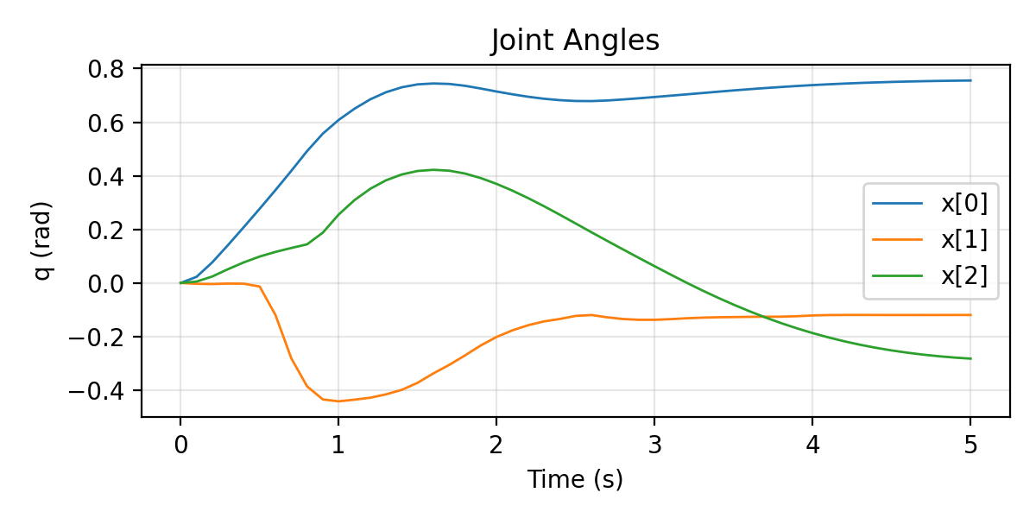
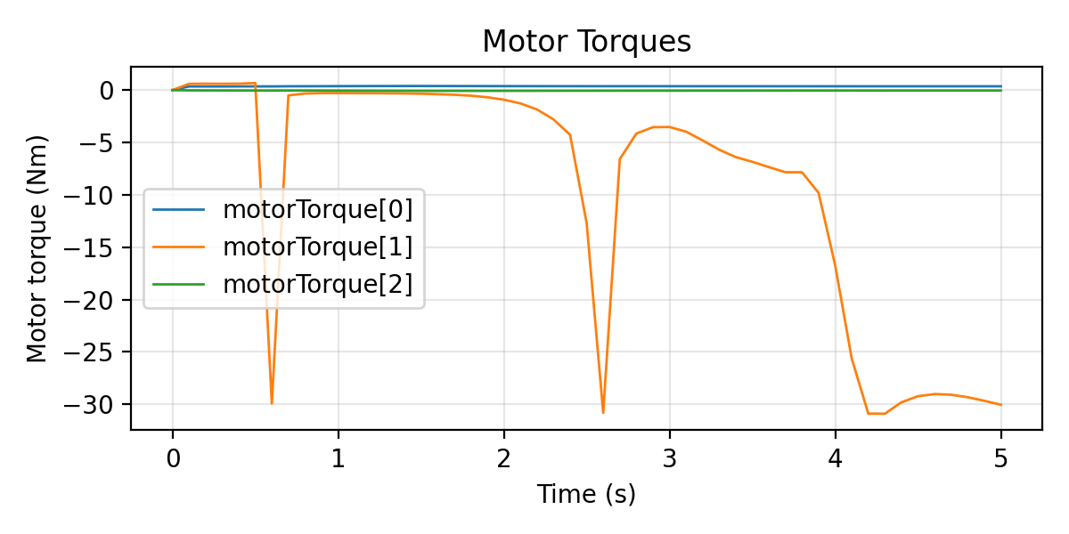
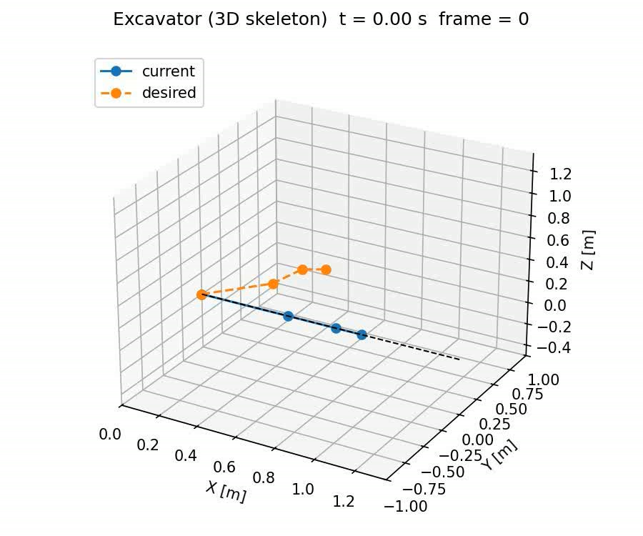
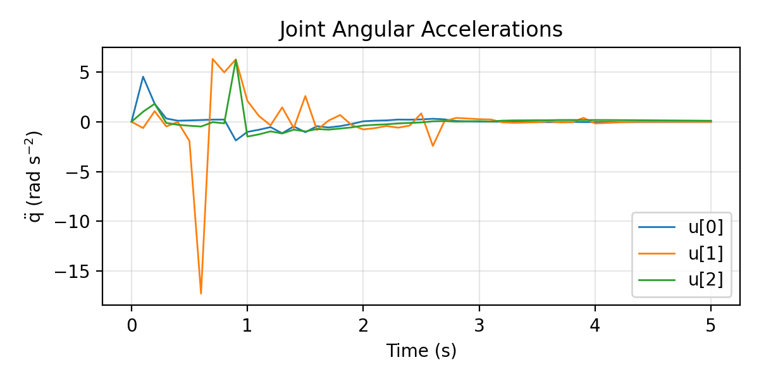
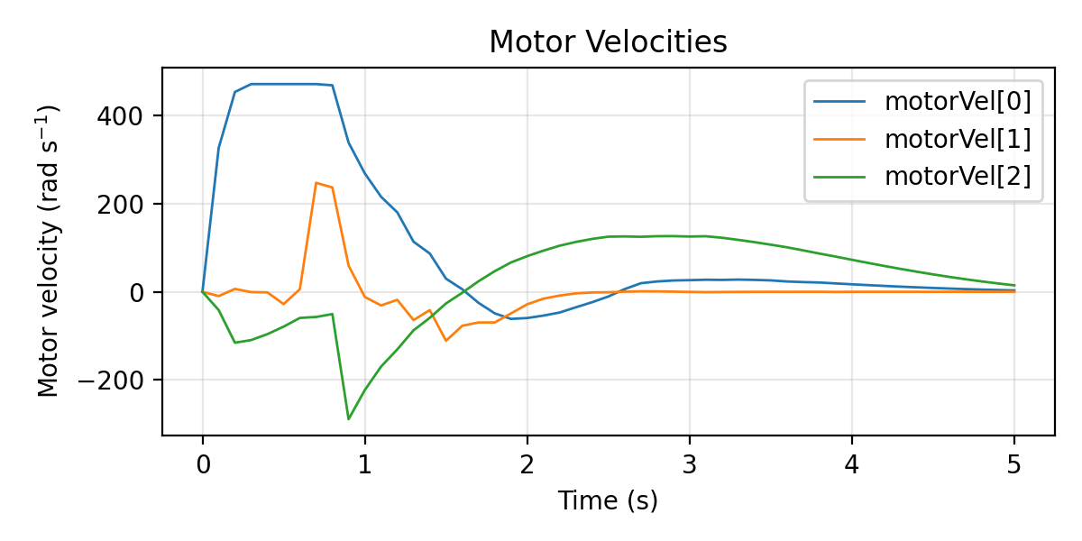

Slide 12
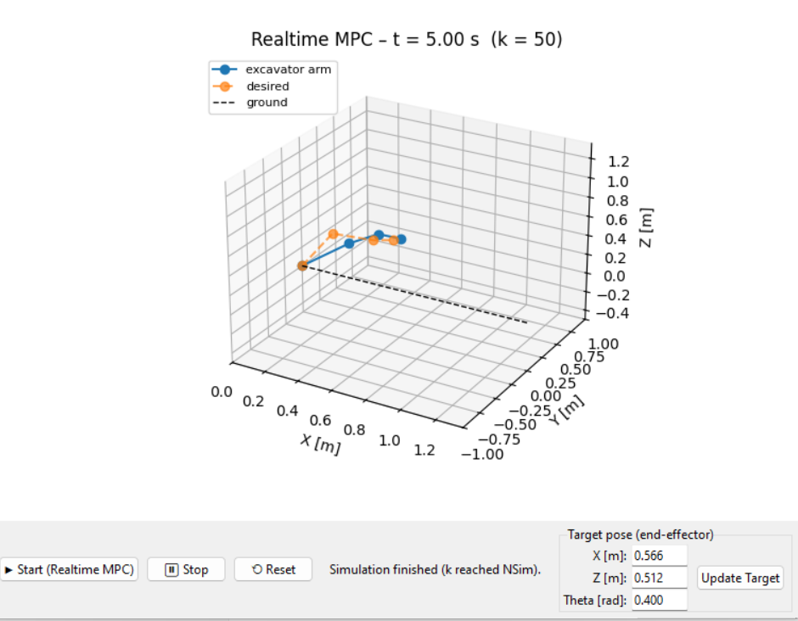
Test2 update the position

Slide 13
base ≈ test_bench（或者 test_bench + mountboom 这一块底座）
boom ≈ liftboom（第一节大臂，负责 lift）
arm ≈ tiltboom（第二节小臂，负责 tilt）
bucket ≈ scoop（铲斗）
tip ≈ end_point（末端点）
test_bench ──fix_to_scene──> mountboom
└─(revolute_lift)──> liftboom ← 对应原来的 boom 关节（jointBoom）
└─(revolute_tilt)──> tiltboom ← 对应原来的 arm 关节（jointArm）
└─(revolute_scoop)──> scoop ← 对应原来的 bucket 关节（jointBucket）
└─FixedJoint──> end_point ← 对应原来的 tip
<joint name="revolute_tilt" origin="0.20564 0 0.420085" parent="liftboom" child="tiltboom"/>
<joint name="revolute_scoop" origin="0.25 0 0" parent="tiltboom" child="scoop"/>

Slide 14
outline
Topic
Goals
Plans
Study resource/ code

Slide 15
Thesis topic
Simulation-based development for a nonlinear excavator system
(with emphasis on practical feasibility and flexible model choice)

Slide 16
Research Goals
1.Use provided excavator model or similar excavator model from open resource to build environment
2. model-based learning model or reinforcement learning model
3.generate a simulation demo for illustrative tasks (such as log lifting or trajectory tracking).
4.optionally implement and compare different control strategies on simulator environment, such as MPC vs PID;

Slide 17
Phase | Main tasks | Timeframe (08.12.2025~1.02.2026)
Planning | Finalise topic, agree responsibilities, write and approve work plan (including analysing the feasibility) | Month 1(December)
Simulation setup | Integrate excavator model, implement dynamics, set up training environment. | Month 1(December)
Controller implementation | Implement a Baseline controller or MPC or learning-based controllers on simulation environment | Month 2(January)
Experiments and analysis | Run simulations, collect data, evaluate performance | Month 2(January)
Writing and finalisation | Write results, discussion, conclusions, revise with supervisor | Month 3(February)

Slide 18
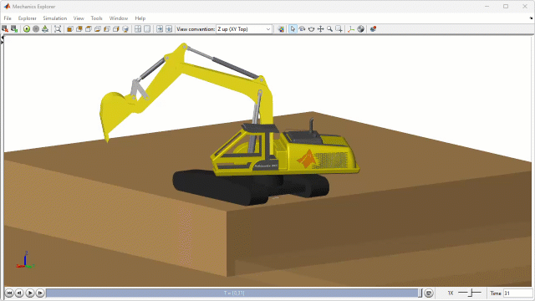
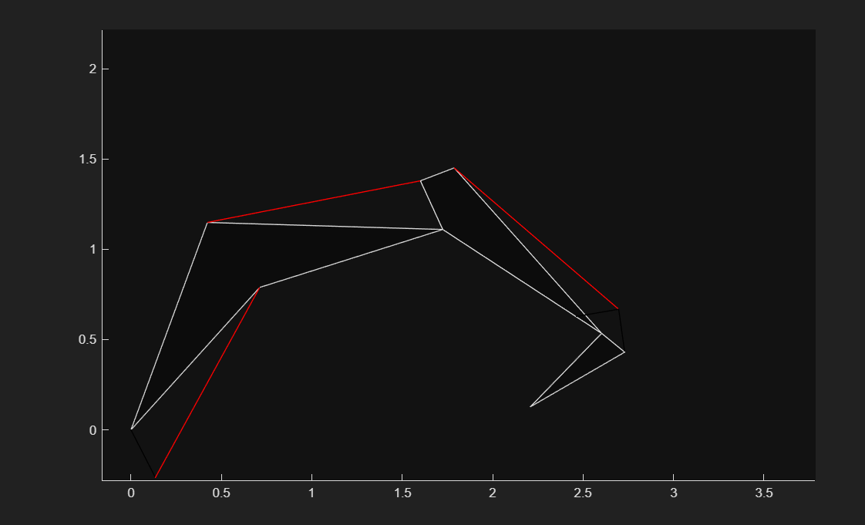
study cases
https://github.com/simscape/Excavator-Simscape
https://github.com/xuexianlim/eXactMPC

Slide 19
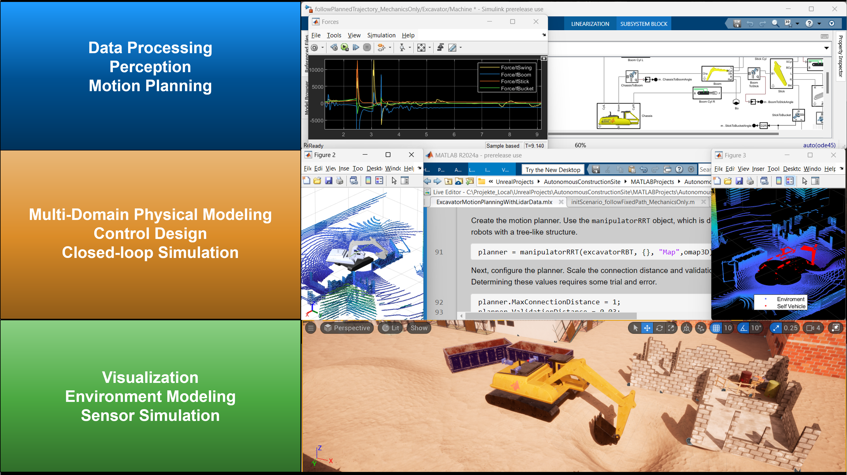
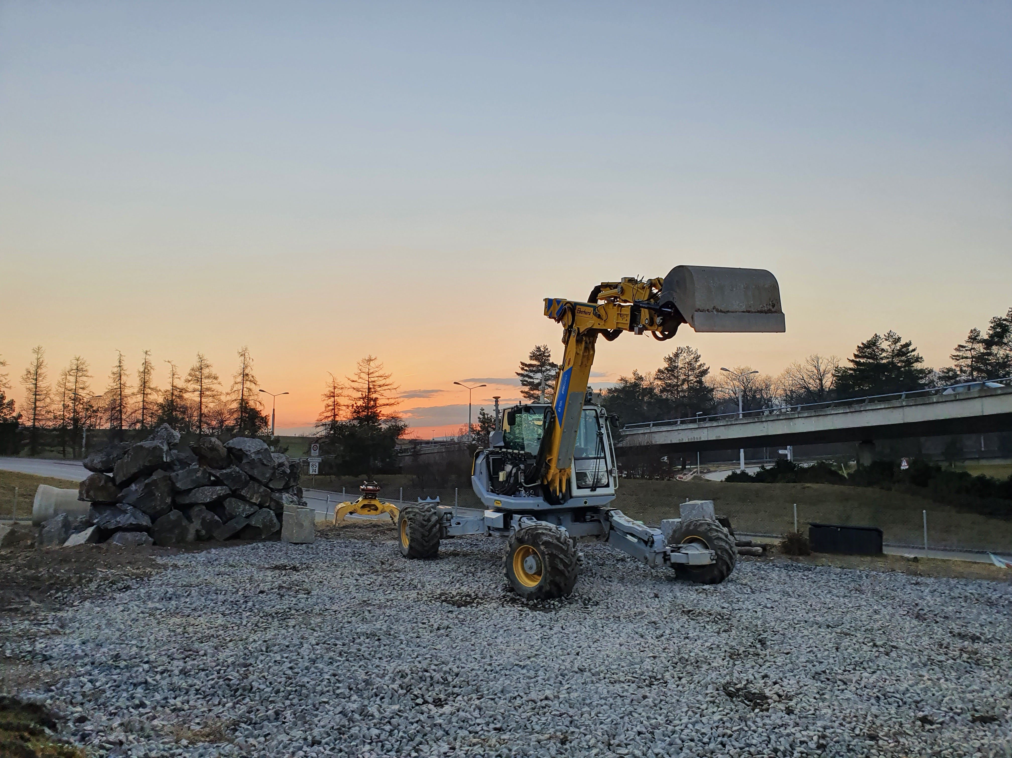
https://github.com/mathworks-robotics/autonomous-excavator
https://github.com/leggedrobotics/rsl_heap

Slide 20
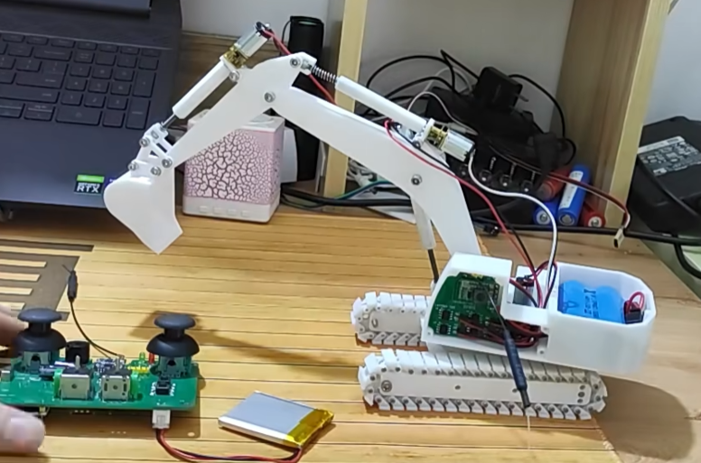
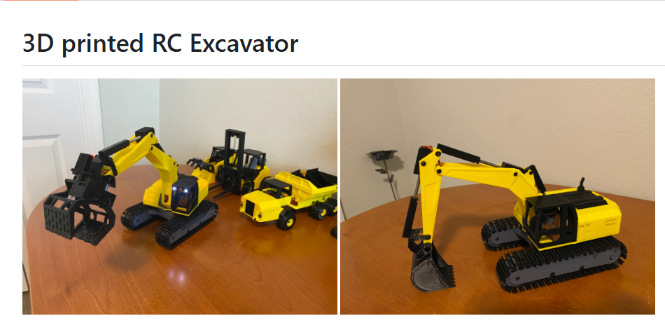
http://bilibili.com/video/BV1jG4y1h7KU/?vd_source=d039de0562f9406b58c45a447595a8b6
# other models
https://github.com/eyhxh/3Dprint-mini-RC-excavator
https://github.com/swholmstead/Excavator

Slide 21
Thanks

